Slide 1
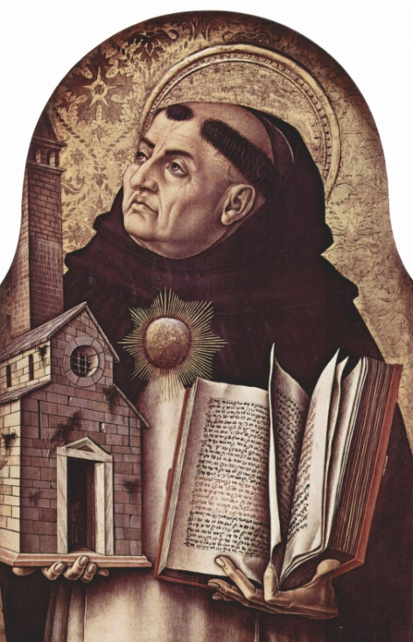
St. Thomas Aquinas
Italian Dominican friar, priest, philosopher and theologian
1225-1274
Thinker, scholar and later a
saint

Slide 2
Changed the landscape of philosophical thought in Europe by combining reason and religion.
Tried to prove the existence of God through philosophy by:
Observing movement in the world as proof of God, the "Immovable Motor”
Observing cause and effect and identifying God as the cause of everything
Concluding that the impermanent nature of beings proves the existence of a necessary being, God, who originates only from within himself

Slide 3
Introduced public to his writings and influenced thought
Major writings – Four Books of Sentences, or Commentary on the Sentences.
On Being and Essence, for the Dominican monks in Paris.
Public began to think more about philosophy, reason and religion
Shared his writings with public through speeches and leadership.

Slide 4
Taught Christians appropriate social behavior for salvation
Three types of laws: natural, positive and eternal.
People should act morally to go to Heaven
Europeans changed behaviors based on his teachings

Slide 5
Bibliography
"St. Thomas Aquinas” Bio.com. A&E Networks Television, n.d. Web. 29 Jan. 2015. http://www.biography.com/people/st-thomas-aquinas-9187231#major-works
"St. Thomas Aquinas." CATHOLIC ENCYCLOPEDIA:. N.p., n.d. Web. 28 Jan. 2015. http://www.newadvent.org/cathen/14663b.htm

